Slide 1
Chapter 2 The Internet and World Wide Web

Slide 2
Chapter 2 Objectives
Discuss the history of the Internet
Describe the types of Web sites
Explain how to access and connect to the Internet
Recognize how Web pages use graphics, animation, audio, video, virtual reality, and plug-ins
Analyze an IP address
Identify the steps required for Web publishing
Identify the components of a Web address
Describe the types of e-commerce
Explain how e-mail, mailing lists, instant messaging, chat rooms, VoIP, FTP, and newsgroups and message boards work
Explain the purpose of a Web browser
Search for information on the Web
Identify the rules of netiquette
Next

Slide 3
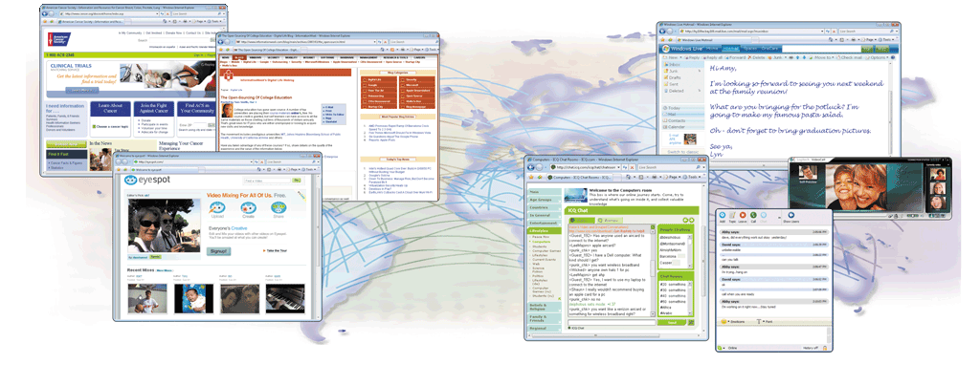
The Internet
What are some services found on the Internet?
p. 68-69 Fig. 2-1
Next

Slide 4
History of the Internet
How did the Internet originate?
ARPANET
Networking project by Pentagon’s Advanced Research Projects Agency (ARPA)
Goal: To allow scientists at different locations to share information
Goal: To function if part of network were disabled
Became functional September 1969
p. 69
Next

Slide 5
History of the Internet
How has the Internet grown?
Today
More than 500 million host nodes
1984
More than 1,000 host nodes
1969
Four host nodes
p. 69
Next

Slide 6
History of the Internet
Who controls the Internet?
No onec—cit is a public, cooperative, and independent network
Several organizations set standards
World Wide Web Consortium (W3C)
Oversees research, sets standards and guidelines
Mission is to contribute to the growth of the Web
Nearly 400 organizations around the world are members of the W3C
Click to view Web Link, click Chapter 2, Click Web Link from left navigation,
then click W3C below Chapter 2
p. 70
Next

Slide 7
How the Internet Works
How can you connect to the Internet?
Slow-speed technology
High-speed connection
Dial-up access modem in your computer uses a standard telephone line to connect to the Internet
DSL, cable modem, FTTP, fixed wireless, wireless modem, Wi-Fi, and satellite modems
Connection must be established each time you log on.
Connection is always on— whenever the computer is running
p. 70
Next

Slide 8
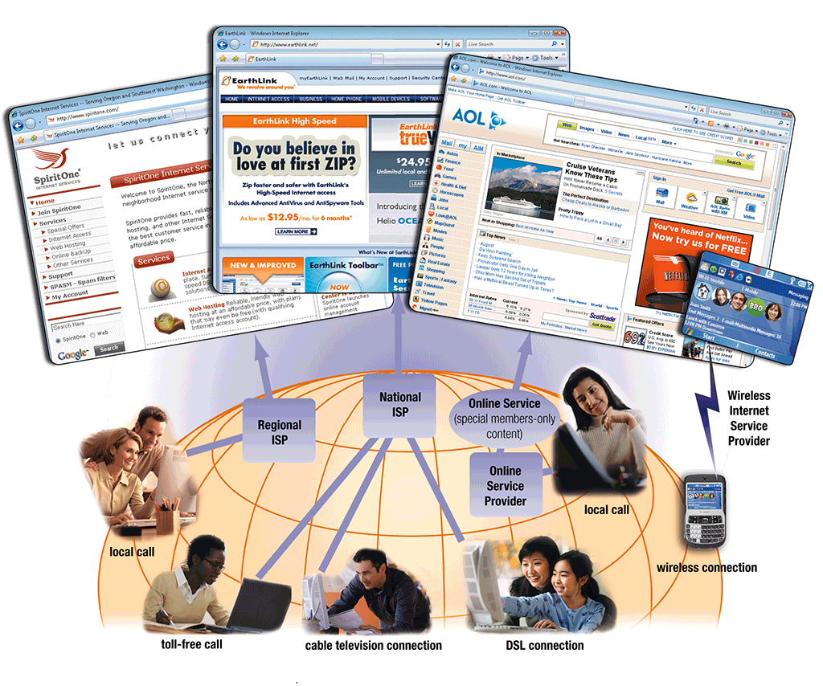
How the Internet Works
What are ways to access the Internet?
ISP, Regional or National
OSP (AOL and MSN, for example)
Wireless Internet Service Provider
Click to view Web Link, click Chapter 2, Click Web Link from left navigation,
then click Modems below Chapter 2
p. 71 – 72 Fig. 2-2
Next

Slide 9
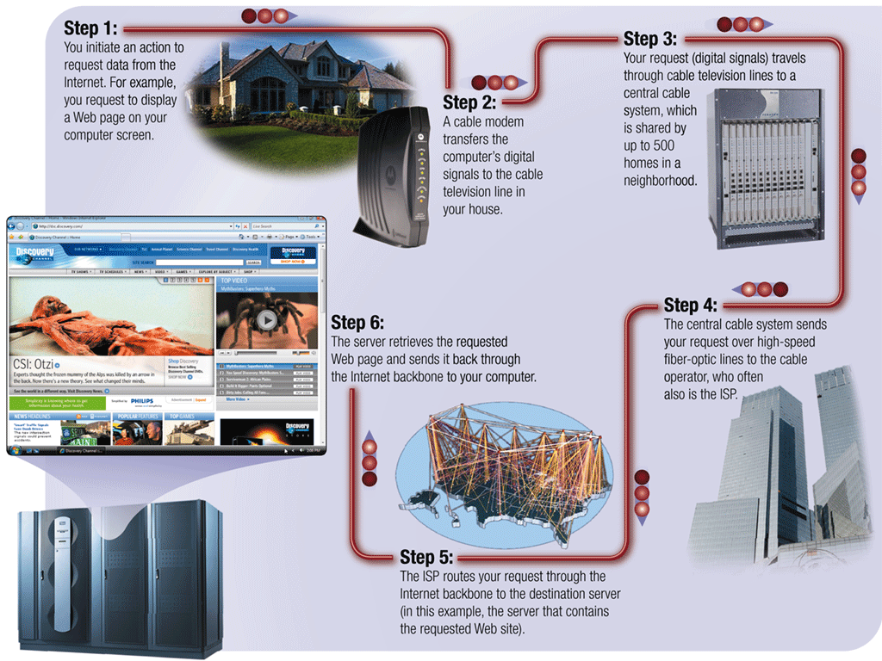
How the Internet Works
How might data travel the Internet using a cable modem connection?
p. 73 Fig. 2-3
Next

Slide 10
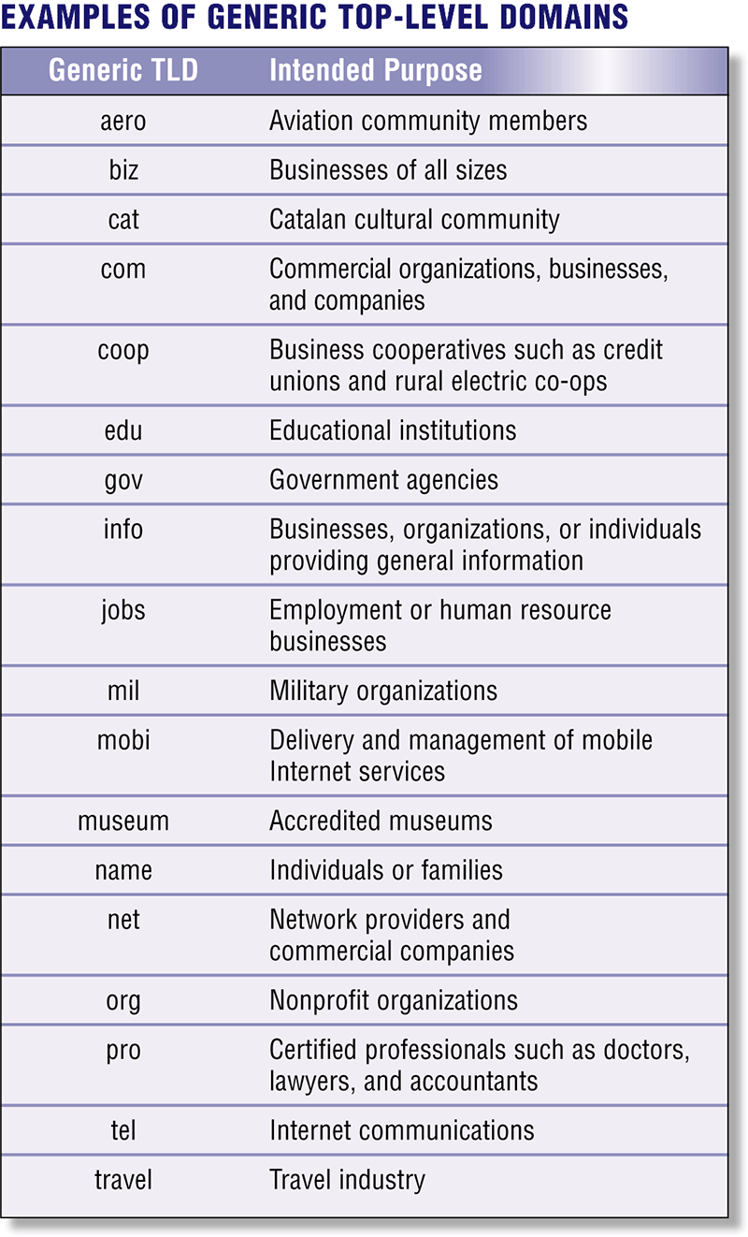
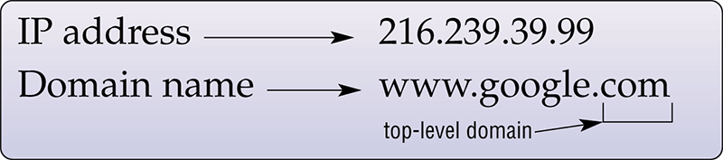
How the Internet Works
What is a domain name?
Text version of Internet protocol (IP) address
Number that uniquely identifies each computer or device connected to Internet
p. 73 - 74 Figs. 2-4 – 2-5
Next

Slide 11
The World Wide Web
What is the World Wide Web (WWW)?
A worldwide collection of electronic documents
Also called the Web
Each electronic document is called a Web page
Can contain text, graphics, audio, video, and built-in connections
A Web site is a collection of related Web pages
p. 75
Next

Slide 12
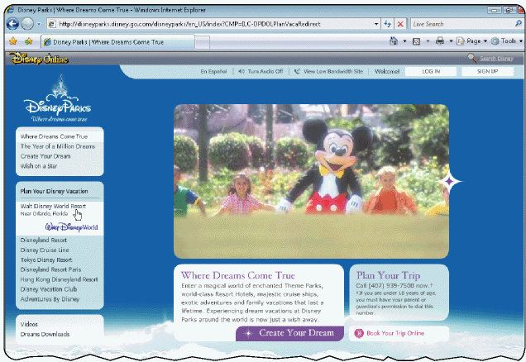
The World Wide Web
What is a Web browser?
Program that allows you to view Web pages
Internet Explorer
Firefox
Netscape
Opera
Safari
p. 75
Next

Slide 13
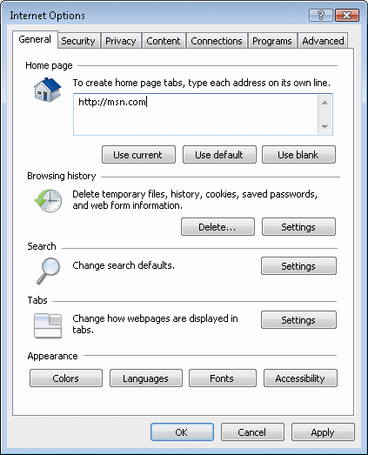
The World Wide Web
How does a Web browser display a home page?
Step 2. Web browser looks up the home page setting
Step 3. The Web browser communicates with the access provider’s server to retrieve the IP address. The IP address is sent to your computer.
Step 1. Click the Web browser program name
Step 4. The home page displays in the Web browser
p. 75 Fig. 2-6
Next

Slide 14
The World Wide Web
What is a home page?
The first page that a Web site displays
Often provides connections to other Web pages
p. 75 - 76 Fig.2-6
Next

Slide 15
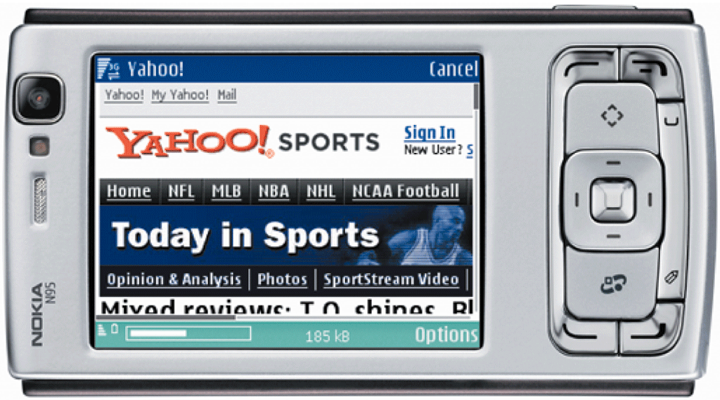
The World Wide Web
How do Internet-enabled mobile devices access the Web?
Use a microbrowser that displays Web pages that contain mostly text
p. 76 Fig. 2-7
Next

Slide 16

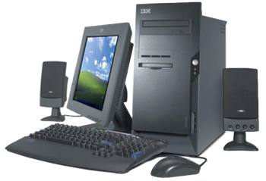
The World Wide Web
What is downloading?
The process of a computer receiving information
Depending upon connection speed, downloading can take from a few seconds to several minutes
p. 76
Next

Slide 17
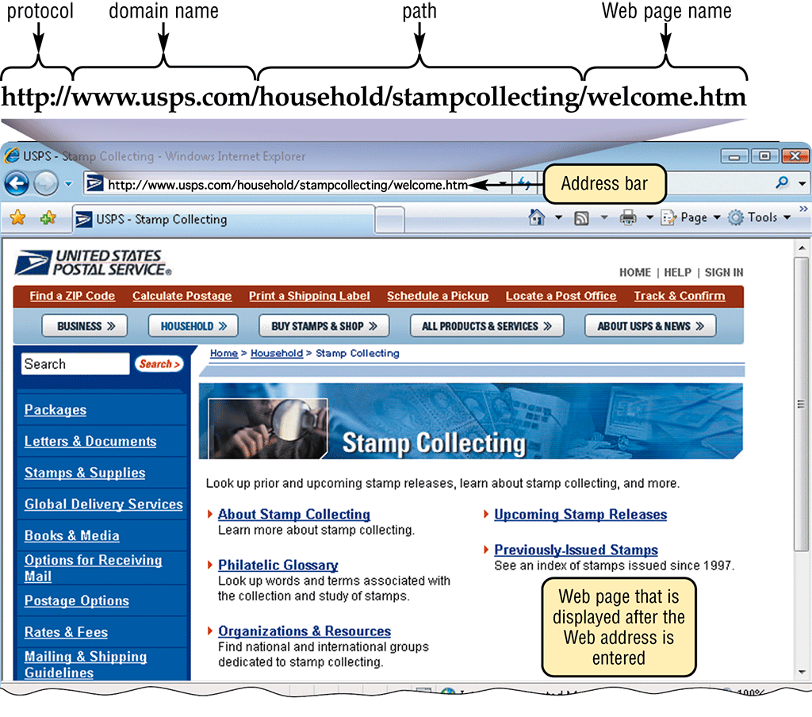
The World Wide Web
What is a URL?
Unique address for a Web page
A web server delivers the Web page to your computer
p. 76 - 77 Fig. 2-8
Next

Slide 18
The World Wide Web
What is a hyperlink (link)?
Built-in connection to another related Web page location
Item found elsewhere on same Web page
Different Web page at same Web site
Web page at a different Web site
p. 76 - 78
Next

Slide 19
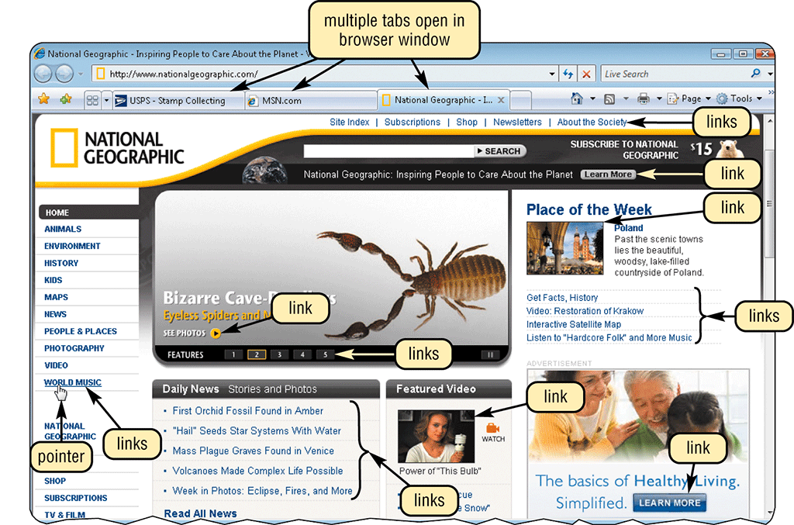
The World Wide Web
How can you recognize links?
Pointer changes to a small hand when you point to a link
A link can be text or an image
Text links are usually underlined and in a different color
p. 77 Fig. 2-9
Next

Slide 20
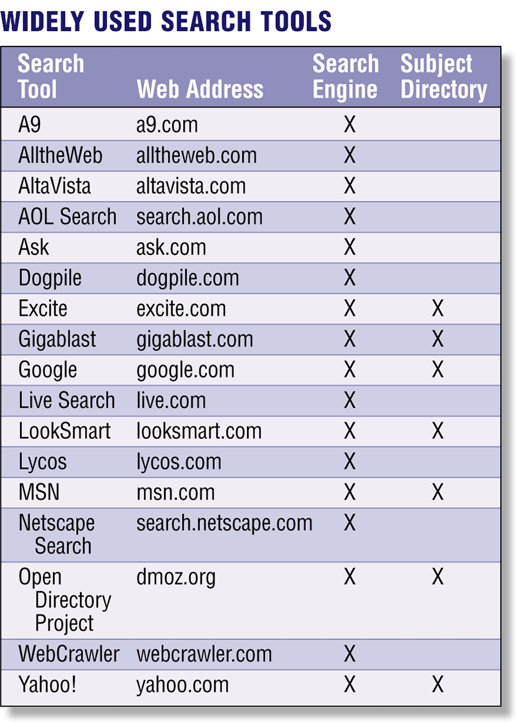
The World Wide Web
What is a search engine?
Program used to find Web sites and Web pages by entering words or phrases called search text
Also called a keyword
p. 78 – 80 Fig. 2-10
Next

Slide 21
The World Wide Web
What is a subject directory?
Search tool with organized set of categories and subcategories
Lets you find information by clicking links rather than entering keywords
p. 78 – 80
Next

Slide 22
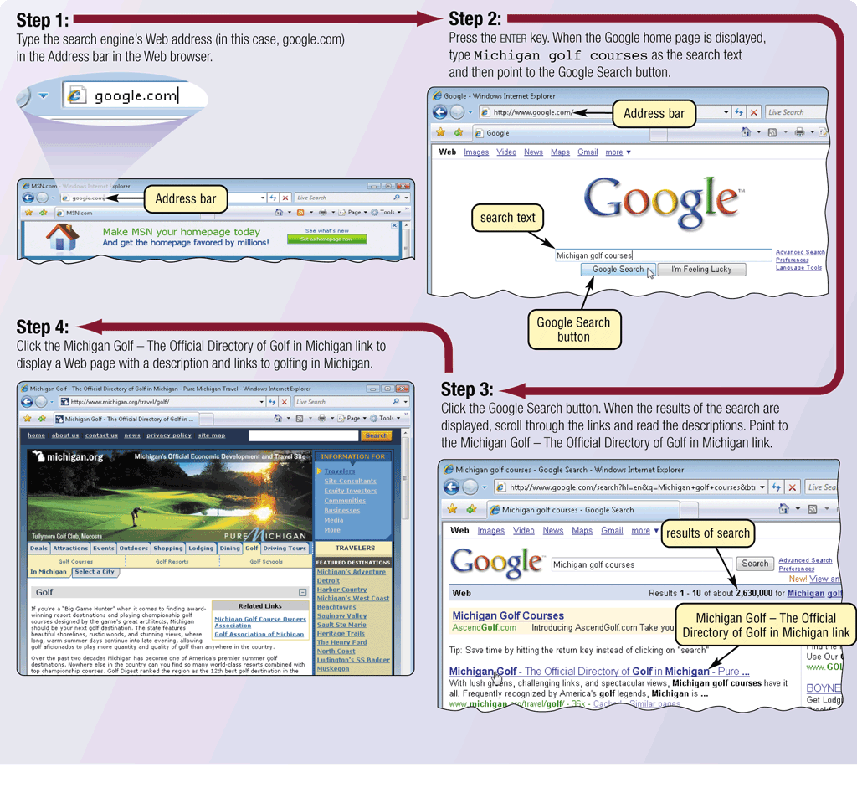
The World Wide Web
What is a hit?
Any Web site name that is listed as the result of a search
p. 80 Fig. 2-11
Next

Slide 23
The World Wide Web
What are the twelve basic types of Web sites?
Portal
News
Informational
Business/ Marketing
Educational
Entertainment
Advocacy
Blog
Wiki
Social Network
Content Aggregator
Personal
p. 82 – 84
Next

Slide 24
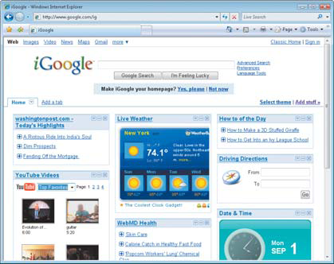
The World Wide Web
What is a portal?
A Web site that offers a variety of services from one, convenient location, usually for free
Searching, news, sports and weather, Web publishing, reference tools, stock quotes, maps, shopping, e-mail, and online communities (Web sites that join people with similar interests)
p. 82 – 83 Fig. 2-14a
Next

Slide 25
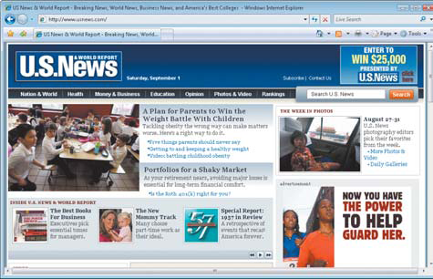
The World Wide Web
What is a news Web site?
Contains newsworthy material
Stories and articles relating to current events, life, money, sports, and the weather
p. 82 - 83 Fig. 2-14b
Next

Slide 26
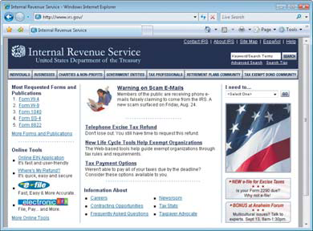
The World Wide Web
What is an informational Web site?
Contains factual information
Created by organizations and government agencies
p. 82 – 83 Fig. 2-14c
Next

Slide 27
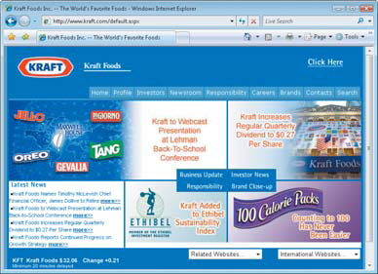
The World Wide Web
What is a business/marketing Web site?
Contains content that promotes products or services
Allows you to purchase products or services online
p. 82 – 83 Fig. 2-14d
Next

Slide 28
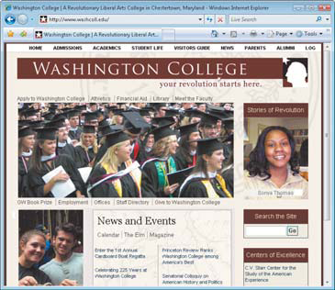
The World Wide Web
What is an educational Web site?
Offers avenues for formal and informal teaching and learning
Learn how airplanes fly or how to cook a meal
Some colleges offer online classes and degrees
p. 82 - 83 Fig. 2-14e
Next

Slide 29
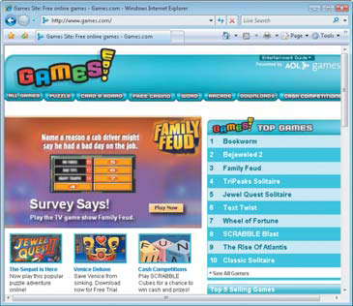
The World Wide Web
What is an entertainment Web site?
Offers an interactive and engaging environment featuring music, videos, sports, games, ongoing Web episodes, sweepstakes, chats, and more
p. 82 - 83 Fig. 2-14f
Next

Slide 30
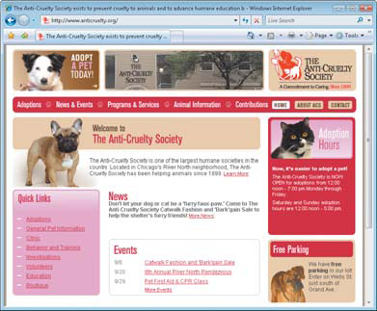
The World Wide Web
What is an advocacy Web site?
Contains content that describes a cause, opinion, or idea
p. 82 - 83 Fig. 2-14g
Next

Slide 31
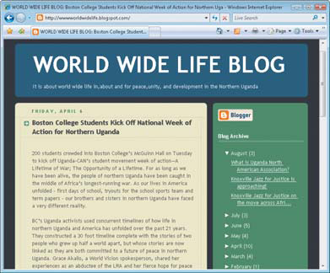
The World Wide Web
What is a blog?
Short for Weblog
Uses a regularly updated journal format to reflect the interests, opinions, and personalities of the author and sometimes site visitors
Video blog (vlog), blogosphere, and vlogosphere
p. 82 - 83 Fig. 2-14h
Next

Slide 32
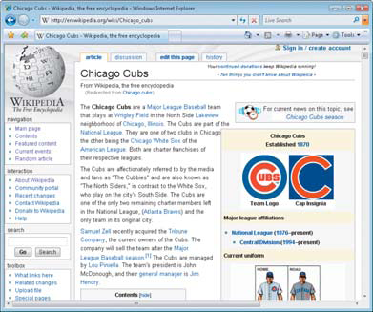
The World Wide Web
What is a wiki?
Collaborative Web site that allows users to create, add to, modify, or delete the Web site content via their Web browser
p. 82-84 Fig. 2-14i
Next

Slide 33
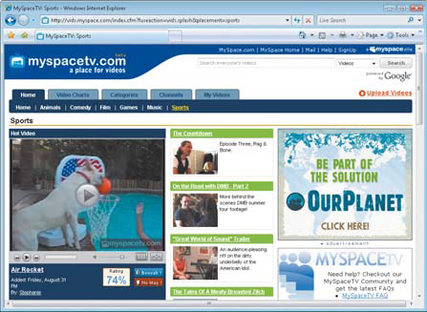
The World Wide Web
What is an online social network?
Encourages members to share their interests, ideas, stories, photos, music, and videos
Media sharing Web site
Click to view Web Link, click Chapter 2, Click Web Link from left navigation,
then click Facebook below Chapter 2
p. 83 - 84 Fig. 2-14j
Next

Slide 34
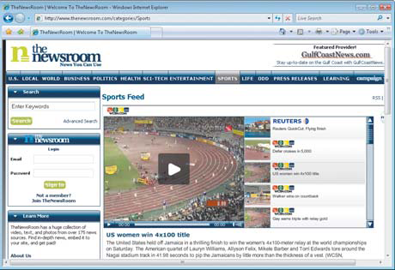
The World Wide Web
What is a content aggregator?
Business that gathers and organizes Web content and then distributes, or feeds, the content to subscribers for free or a fee
p. 83 - 84 Fig. 2-14k
Next

Slide 35
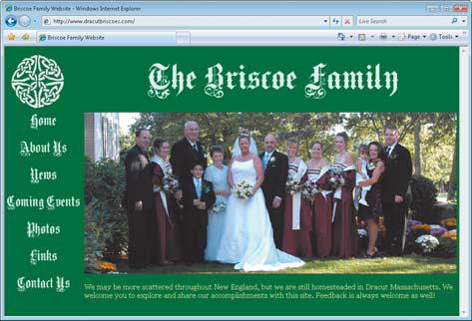
The World Wide Web
What is a personal Web site?
Web page maintained by private individual or family
Reasons: sharing life experience with the world or job hunting
p. 83 - 84 Fig. 2-14l
Next

Slide 36
The World Wide Web
What are the guidelines for evaluating the value of a Web site?
Affiliation
Audience
Authority
Content
Currency
Design
Objectivity
p. 84 Fig. 2-15
Next

Slide 37
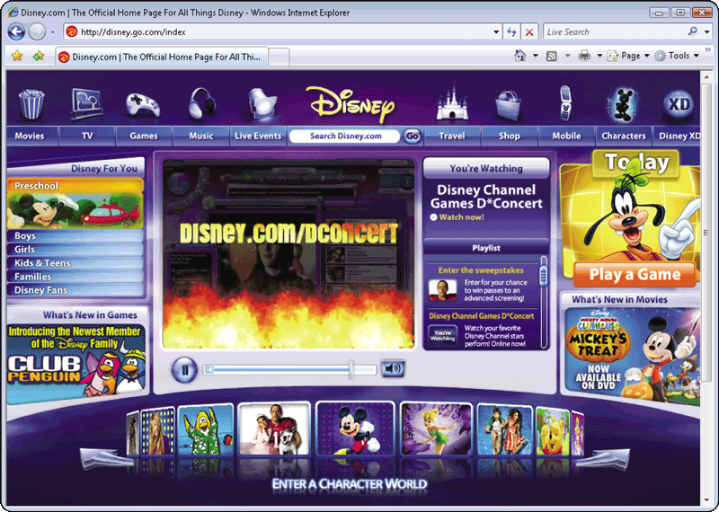
The World Wide Web
What is multimedia?
Application combining text with other media elements
Graphics
Animation
Audio
Video
Virtual reality
Plug-ins
p. 85, 89 Fig. 2-16
Next

Slide 38
The World Wide Web
What graphics formats are used on the Web?
BMP
GIF (pronounced JIFF)
JPEG (pronounced JAY-peg)
PNG (pronounced ping)
TIFF
p. 85 Fig. 2-17
Next

Slide 39
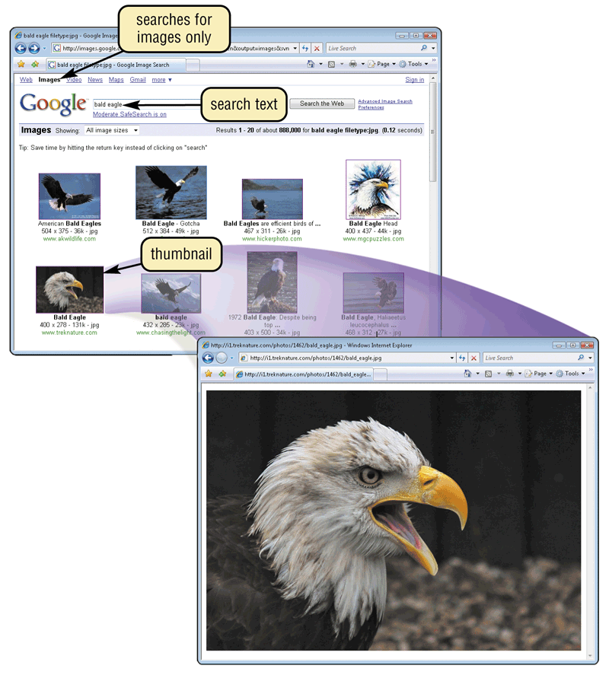
The World Wide Web
What is a thumbnail?
Small version of a larger graphicc—used to improve Web page display time
Usually click on thumbnail to display larger graphic
p. 86 Fig. 2-18
Next

Slide 40
The World Wide Web
What is animation?
Appearance of motion created by displaying a series of still images in sequence
p. 86
Next

Slide 41
The World Wide Web
What is audio?
Music, speech, or any other sound
Individual compressed sound files that you download from the Web to your computer
Common Web audio file formats are AAC, AIFF, ASF, MP3, WAV, WMA, RA, and QT
Once downloaded, you can play (listen to) the contents of the files
A podcast is recorded audio, usually an MP3 file, stored on a Web site that can be downloaded to a computer or a portable media player
p. 86 - 87 Fig. 2-20
Next

Slide 42
The World Wide Web
What is streaming audio?
The process of transferring audio in a continuous and even flow
Enables you to listen to music as it downloads to your computer
p. 86
Next

Slide 43
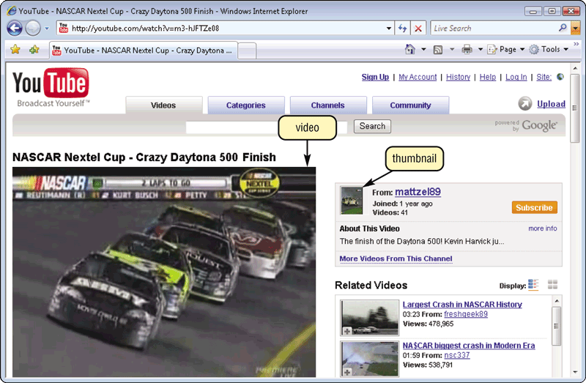
The World Wide Web
What is video?
Consists of full-motion images, most with sound, that are played back at various speeds
MPEG (Moving Pictures Experts Group) is popular video compression standard
Click to view Web Link, click Chapter 2, Click Web Link from left navigation,
then click YouTube below Chapter 2
p. 88 Fig. 2-21
Next

Slide 44

The World Wide Web
Video: Tell Your Stores via Vlog
CLICK TO START
Next

Slide 45
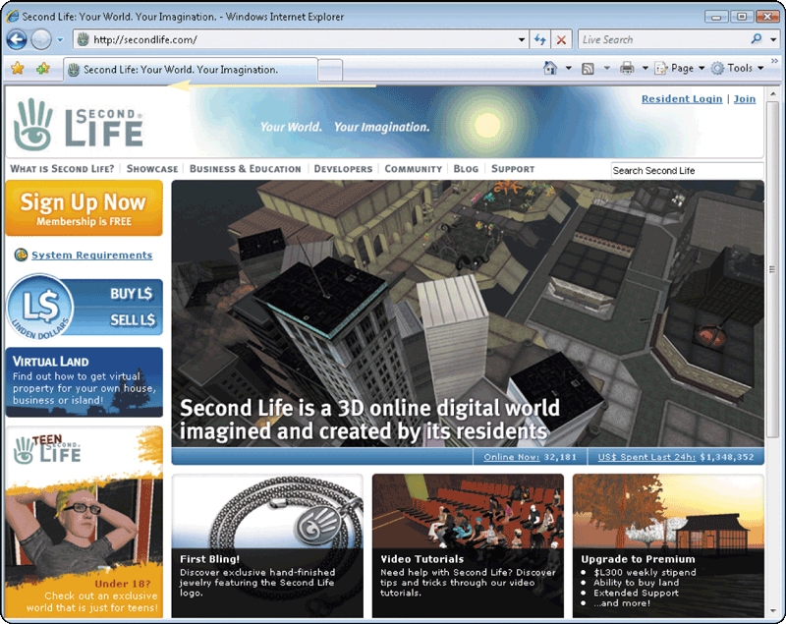
The World Wide Web
What is virtual reality (VR)?
Use of computers to simulate real or imagined environment
Appears as a three dimensional (3-D) space
Used for games and many practical applications
p. 88 – 89 Fig. 2-22
Next

Slide 46
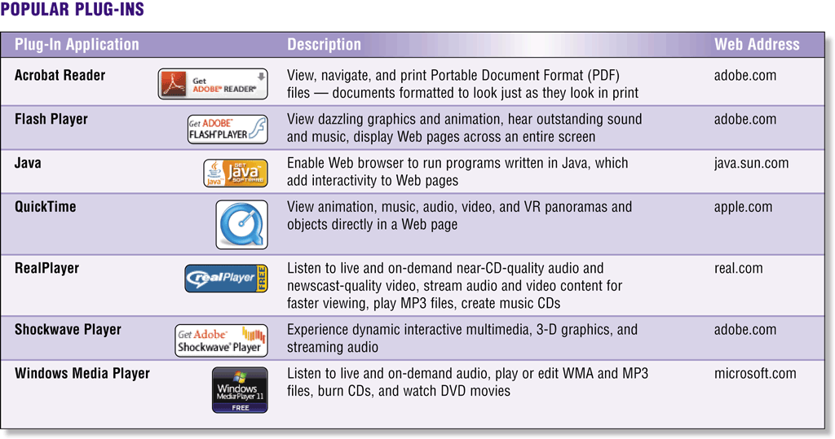
The World Wide Web
What are plug-ins?
Programs that extend the capability of a browser
You can download many plug-ins at no cost from various Web sites
p. 89 Fig. 2-23
Next

Slide 47
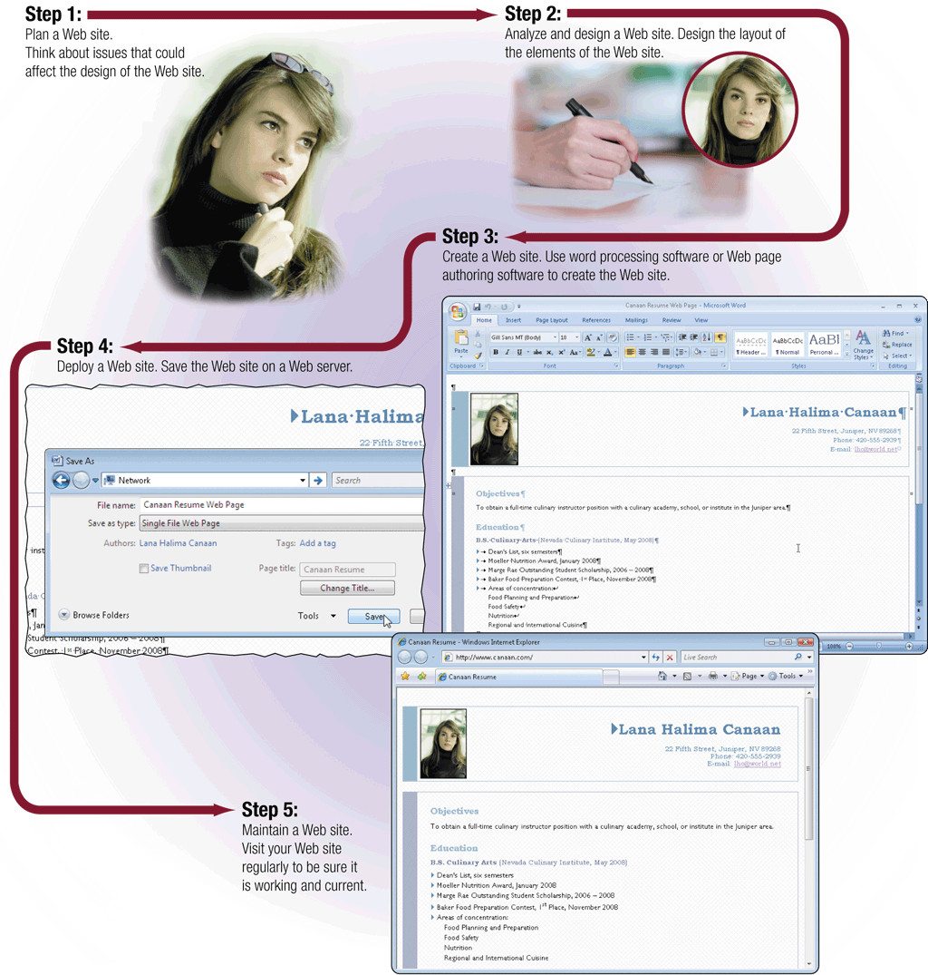
The World Wide Web
What is Web publishing?
Development and maintenance of Web pages
p. 89 - 90 Fig. 2-24
Next

Slide 48

E-Commerce
What is e-commerce?
Short for electronic commerce
Business transaction that occurs over the Internet
Business to consumer (B2C) Sale of goods to general public
Consumer to consumer (C2C) One consumer sells directly to another
Business to business (B2B) Business providing goods and services to other businesses
Click to view Web Link, click Chapter 2, Click Web Link from left navigation,
then click PayPal below Chapter 2
p. 91 - 92 Fig. 2-25
Next

Slide 49

Other Internet Services
What is e-mail?
Short for electronic mail
The transmission of messages and files via a computer network
Messages can consist of simple text or can contain attachments, such as documents, graphics, or audio/video clips
Internet access providers usually provide an e-mail program
Some Web sites—such as Google Gmail, Windows Live Hotmail, and Yahoo! Mail—provide free e-mail services
One of the original services on the Internet
Click to view Web Link, click Chapter 2, Click Web Link from left navigation,
then click E-Mail below Chapter 2
p. 92 - 94
Next

Slide 50
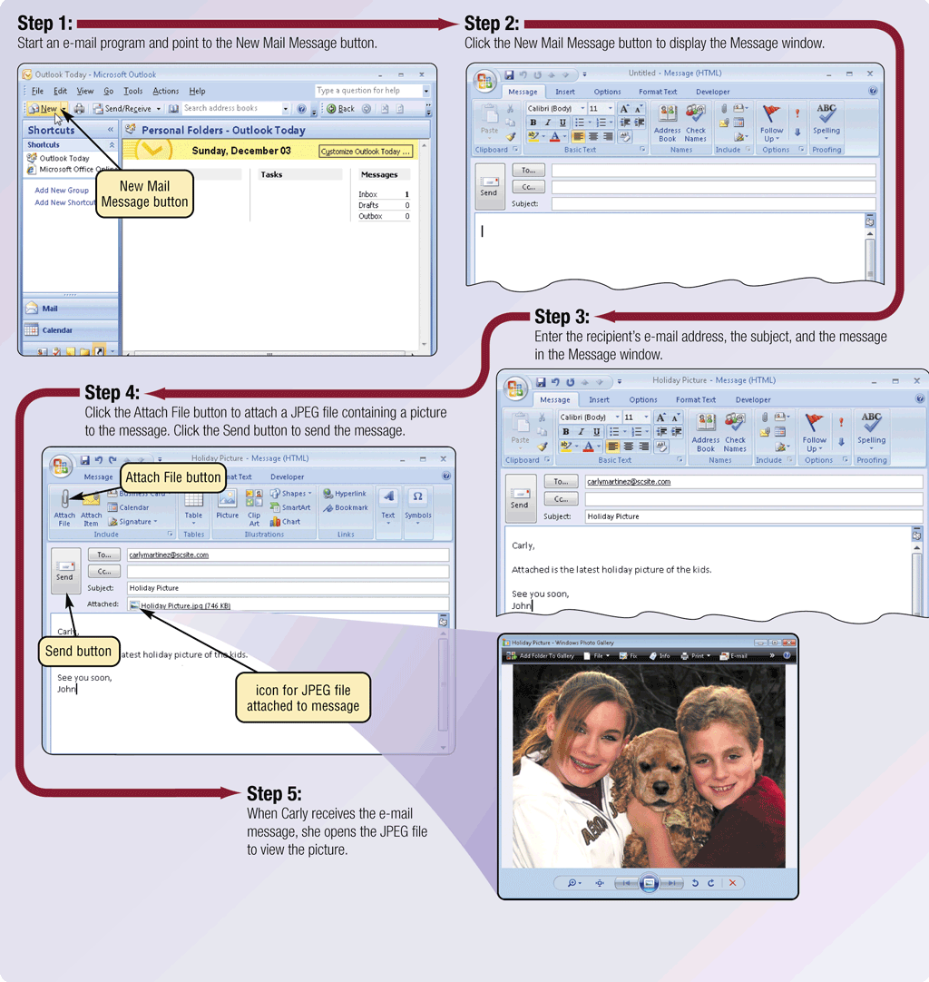
Other Internet Services
How do you send an e-mail message?
p. 93 Fig. 2-26
Next

Slide 51

Other Internet Services
What is an e-mail address?
Unique name that consists of a user name and domain name that identifies the user
p. 94 Fig. 2-27
Next

Slide 52
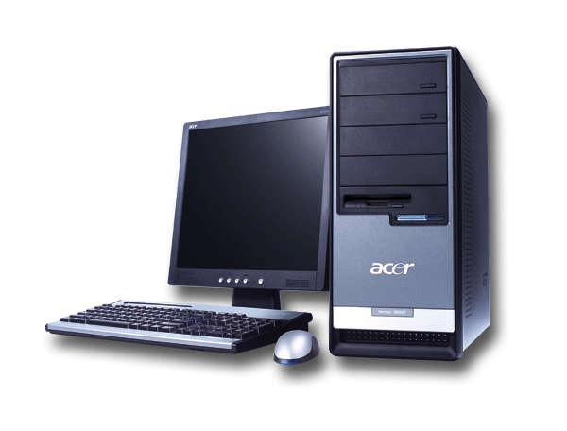

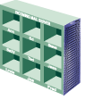

Other Internet Services
How does an e-mail message travel?
Step 1. Using e-mail software, you create and send message
Step 2. Your software contacts software on your service provider’s outgoing mail server
Step 4. When recipient uses e-mail software to check for e-mail messages, the message transfers from incoming mail server to recipient’s computer
Step 3. Software on outgoing mail server determines best route for data and sends message, which travels along Internet routers to recipient’s incoming mail server
p. 95 Fig. 2-28
Next

Slide 53
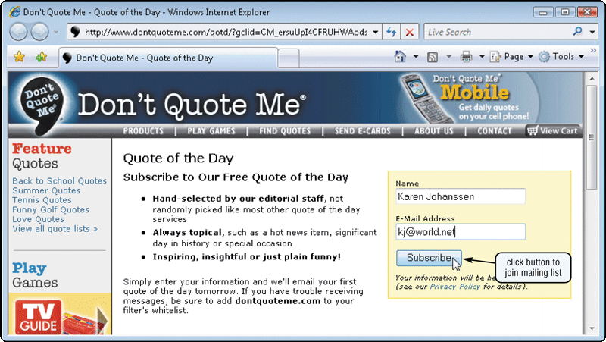
Other Internet Services
What is a mailing list?
Group of e-mail names and addresses given a single name
When a message is sent to the mailing list, everyone on the list receives the message
To add your name to a mailing list you must subscribe to it; to remove your name you must unsubscribe
Click to view Web Link, click Chapter 2, Click Web Link from left navigation,
then click Mailing Lists below Chapter 2
p. 96 Fig. 2-29
Next

Slide 54
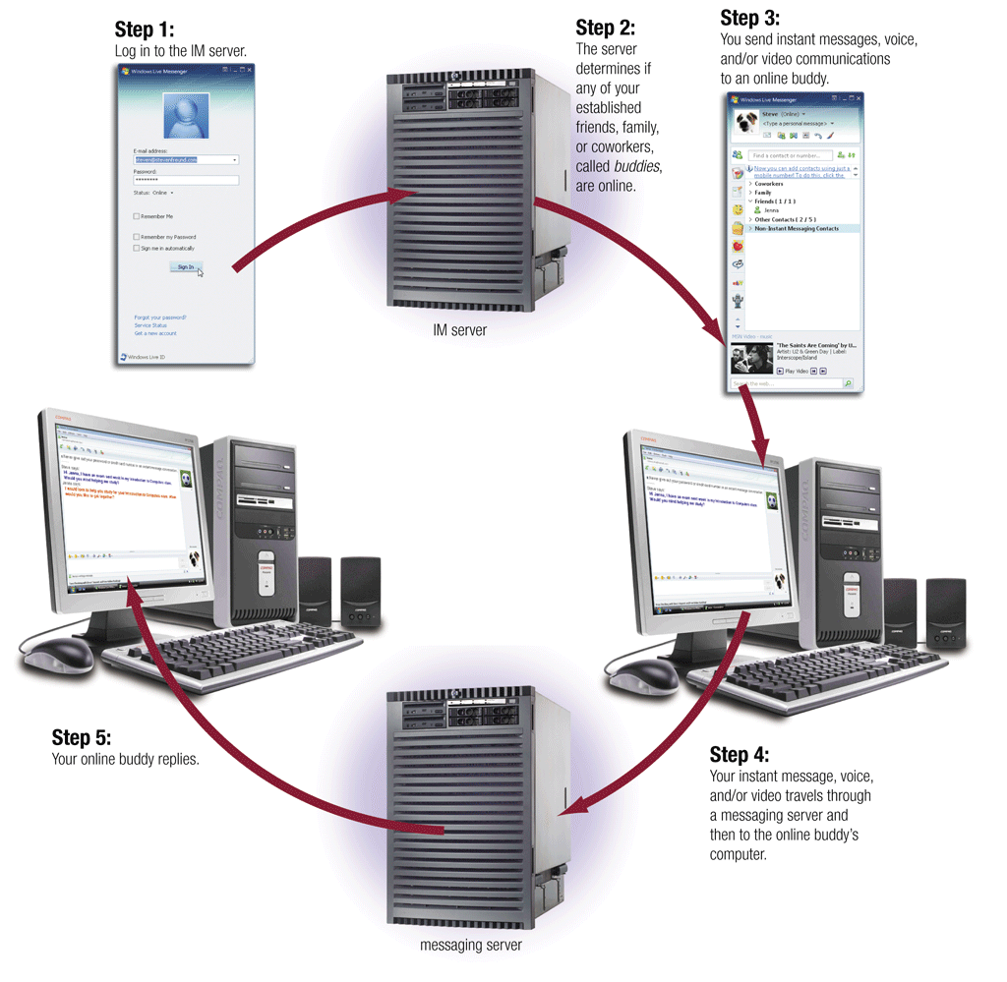
Other Internet Services
What is instant messaging (IM)?
A real-time Internet communications service that notifies you when one or more people are online and allows you to exchange messages or files
p. 96 - 97 Fig. 2-30
Next

Slide 55
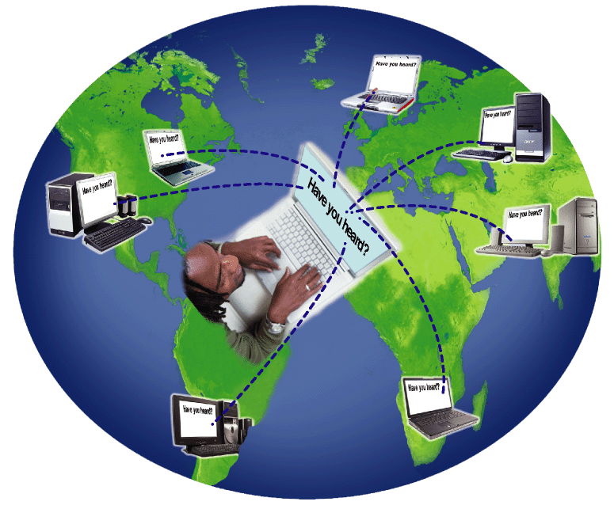
Other Internet Services
What is a chat?
Real-time typed conversation that takes place on a computer
Chat room is location on server that permits users to discuss topics of interest
Click to view Web Link, click Chapter 2, Click Web Link from left navigation,
then click Chat Rooms below Chapter 2
p. 97 - 98 Fig. 2-31
Next

Slide 56
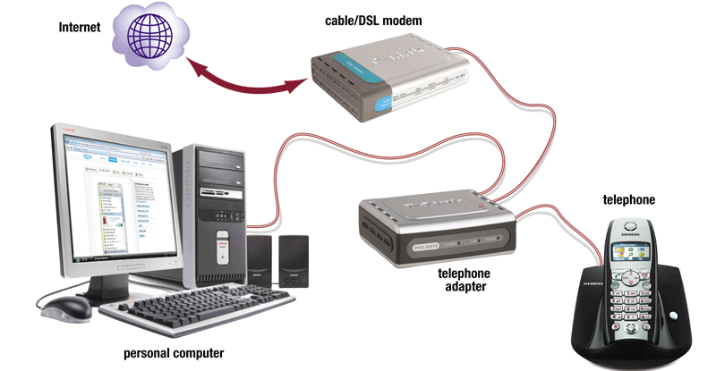
Other Internet Services
What is VoIP (Voice over IP)?
Enables users to speak to other users over the Internet
p. 98 - 99 Fig. 2-32
Next

Slide 57
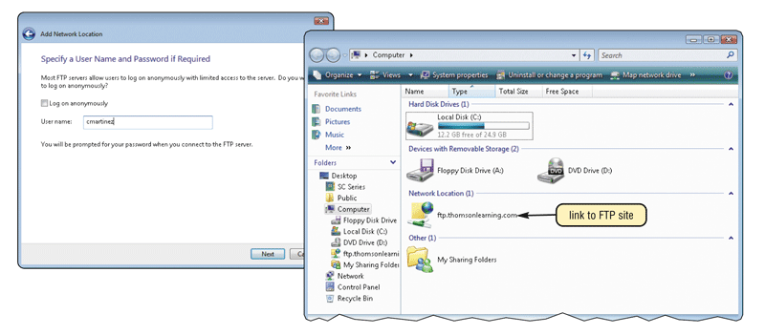
Other Internet Services
What is FTP?
File Transfer Protocol—Internet standard that allows you to upload and download files with other computers on the Internet
Click to view Web Link, click Chapter 2, Click Web Link from left navigation,
then click FTP below Chapter 2
p. 98 – 99 Fig. 2-33
Next

Slide 58
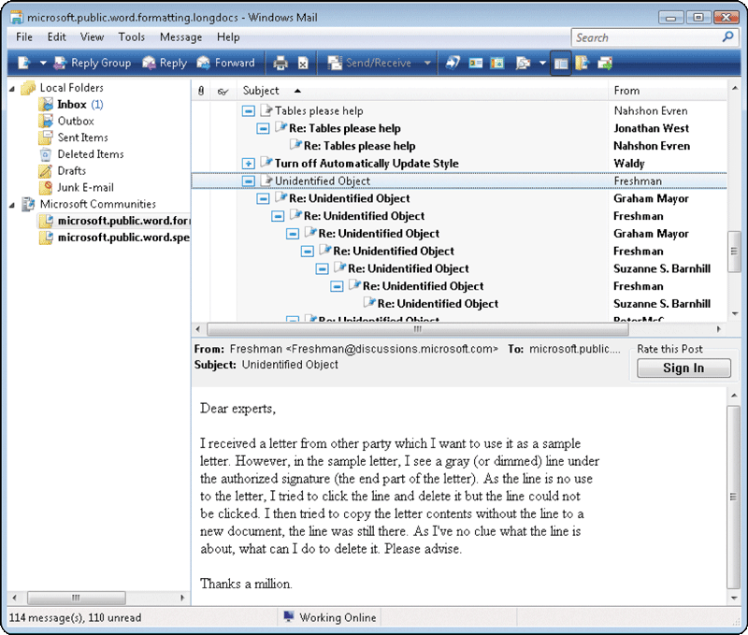
Other Internet Services
What are newsgroups and message boards?
Newsgroup
Online area where users discuss a particular subject
Message board
Type of discussion group
Many Web sites use message boards because they are easier to use
p. 100 Fig. 2-34
Next

Slide 59
Netiquette
What is netiquette?
Code of acceptable behaviors users should follow while on the Internet
Golden Rule: Treat others as you would like them to treat you.
p. 100 Fig. 2-35
Next

Slide 60
Summary of the Internet and World Wide Web
History and structure of the Internet
Electronic commerce
The World Wide Web
Other Internet services
Web Publishing
Netiquette
Chapter 2 Complete

